Slide 1


Slide 2


REAL ESTATE DEVELOPMENT PROJECT IN FLORIDA, USA
April 2019

Slide 3
Contents
Aventura Quattro
Project summary and concept
Market evidence and development pro forma
Conclusions and development recommendations

Slide 4
1. Project summary and preliminary concept for Aventura Quattro
Townhouses residential development project
in Ojus Urban District, Florida

Slide 5
Contents
Project summary and preliminary concept 3
Market evidence and development pro forma 10
Conclusions and development recommendations 20

Slide 6
Confirmation of investment objectives
Investor intends to redevelop land parcel located in Ojus Urban District.
Townhouses complex consisted of 4 units for sale is seen as a prevailing use in the proposed development
Investor has elaborated preliminary development concept that envisions 4 two-story residential townhouses with 2 car garage on the parcel
Investor’s preliminary concept focuses on offering a competitive product in prestigious location tailored to a family households.
Investor anticipates the buildings will be constructed as Concrete Base Structures (CBS) with poured concrete and metal partitions
Preliminary development concept complies with existing zoning regulations and does not imply requesting variances and zoning changes
Investor wants to understand financial feasibility of this preliminary development concept and test it against market fundamentals
Investor wants to start project immediately, subject to obtaining respective approvals and entitlements and closing of financing arrangements

Slide 7
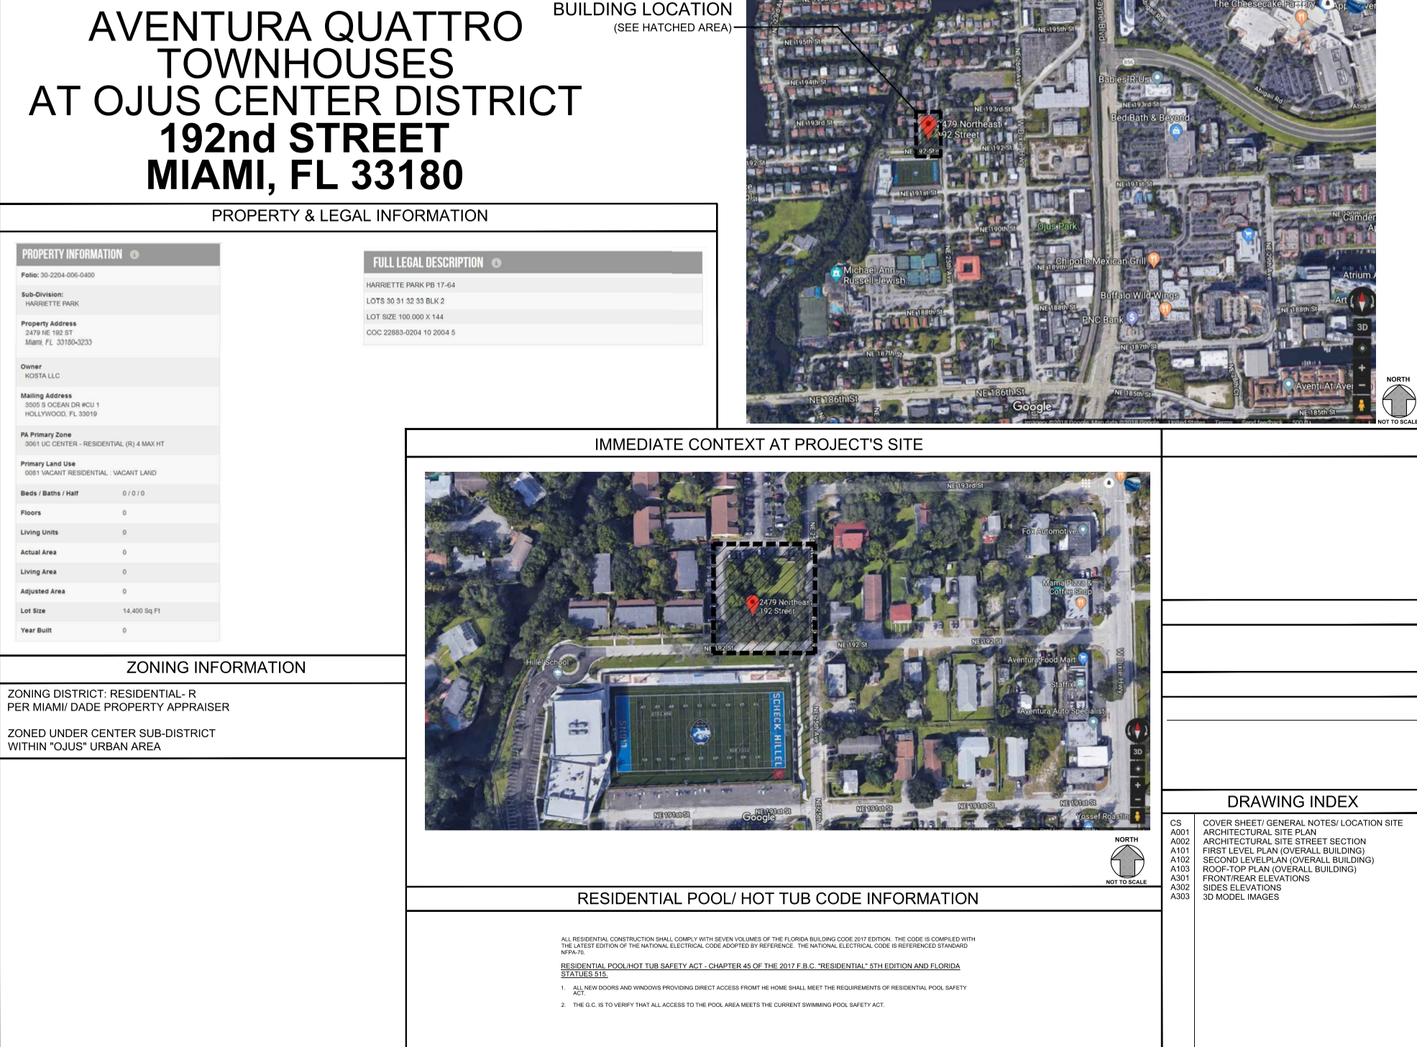
Overview

Slide 8
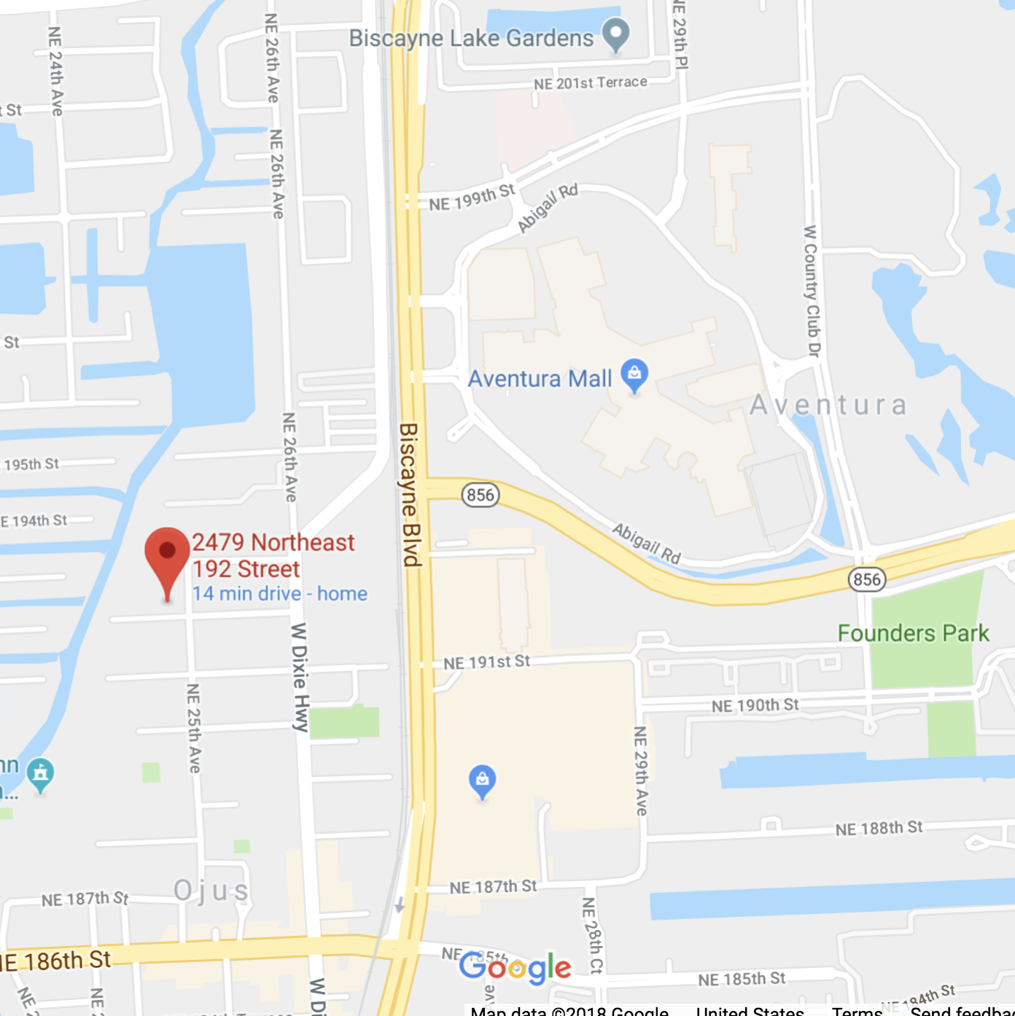
Project location features
General
Located in Ojus Urban District across private Scheck Hillel School
Non-oceanfront (oceanfront is two miles east)
Land area
Parcel ( tax ID – 30-2204-006-0400) – 14,400 s.f.
Access and visibility
Adequate frontage on 192nd street
0.5 miles west of Aventura Malll
2 miles east of I-95
Across the street from Private School Stadium
Surroundings
Predominantly multi-family residential
Existing structures
On parcel – none

Slide 9
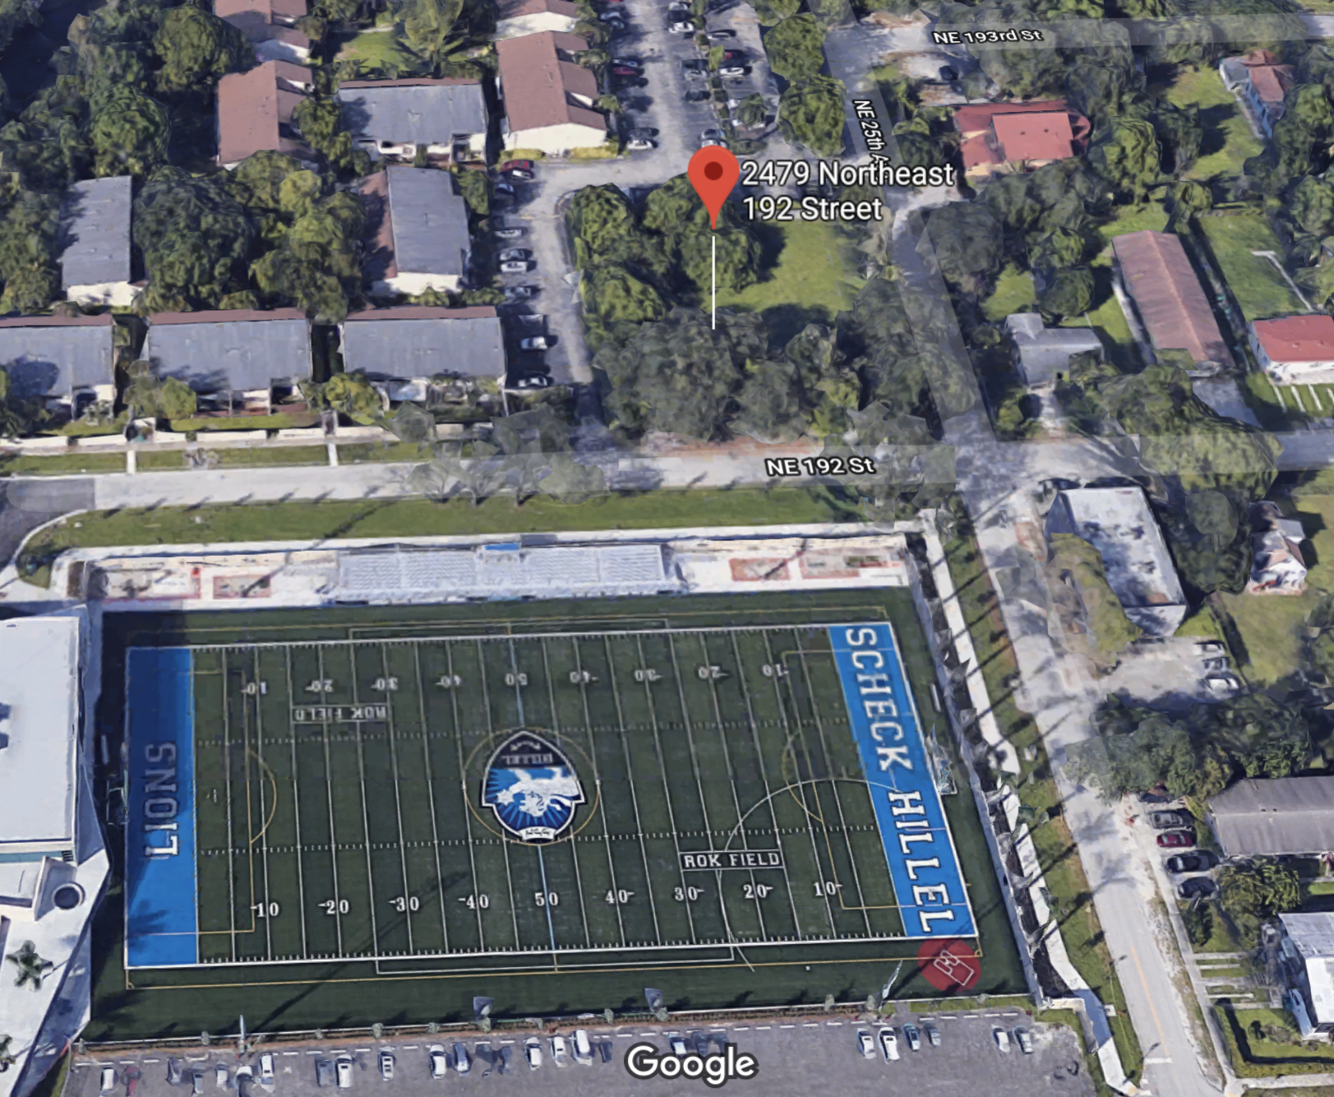
Aerial view
144 feet
0.33 AC
100 feet

Slide 10
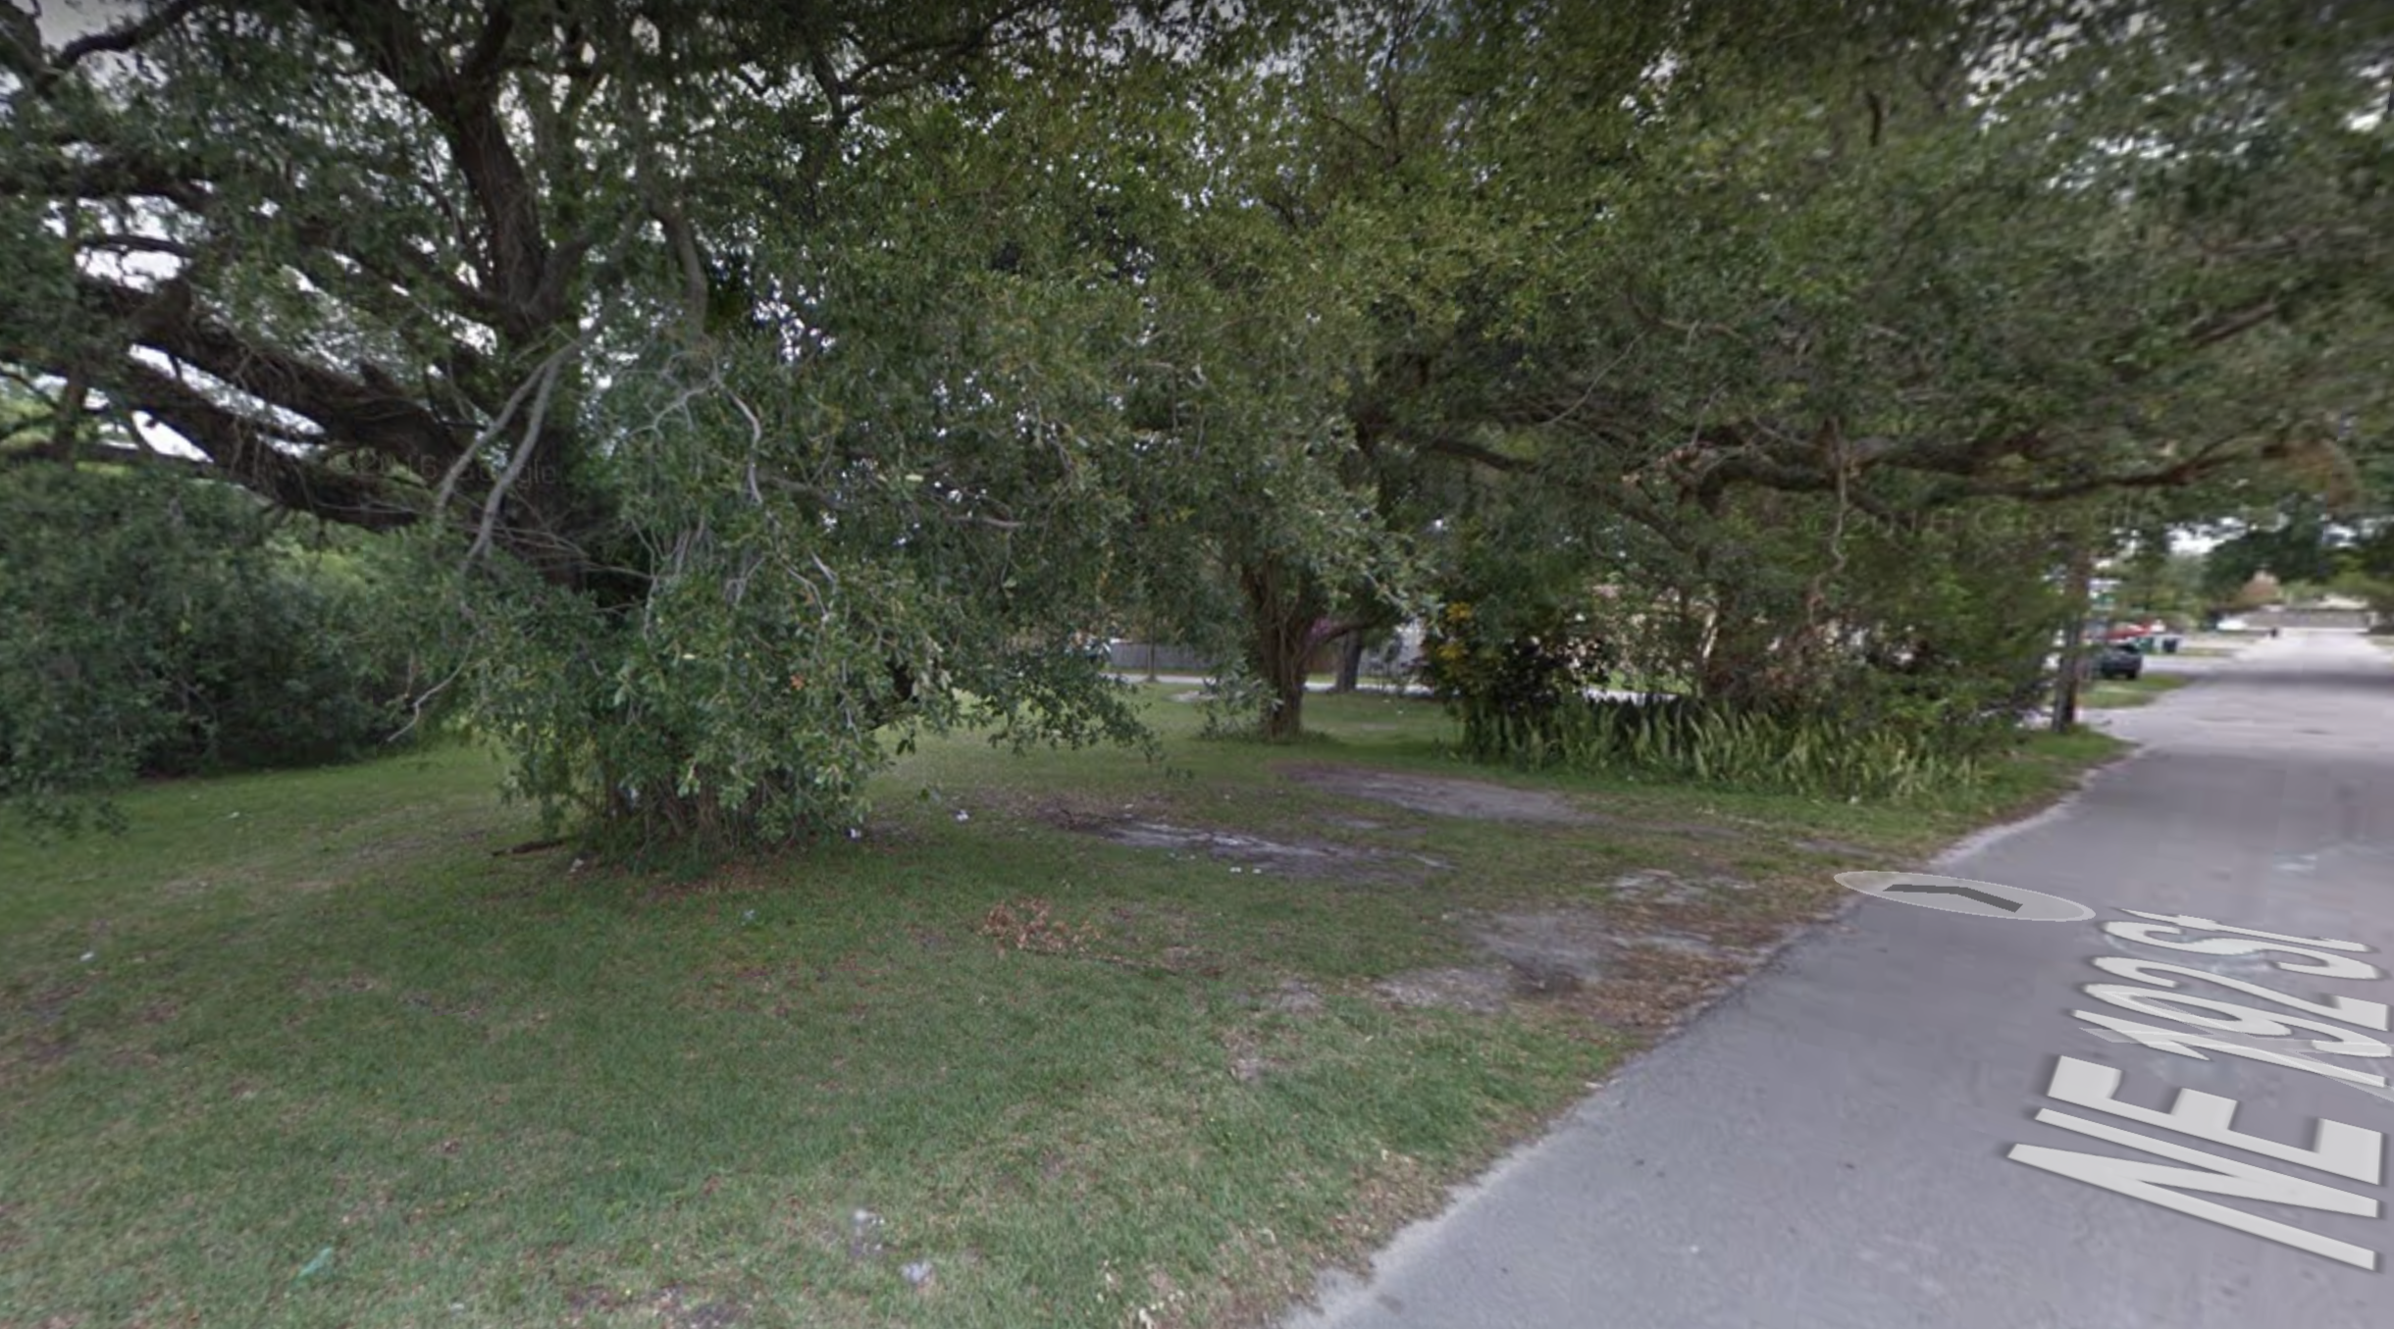
Street views
Facing 192nd st.

Slide 11
Zoning regulations
Functional zone | R (Residential)
Townhouses | Permitted by right, except for on ground level garages facing 192nd St
Commercial uses | Not permitted
Density | Maximum of 4 units permitted
Building height | Max 4 stories
Max floorplate | 45,000 - for single mixed-use tower; 35,000 s.f. per tower when there are several towers on single site
Parking requirements:
Multifamily | min 2 spaces per unit
Is underground parking permitted? | No explicit restrictions found in Broward county zoning regulations
Notes:
Andrey Shanin:
According to Broward County Land Code any roofed parking structure (including open basement parking) has to be included in Gross Floor Area and that way counts towards FAR.
Floor area, gross. The sum of the floor areas of all floors of a building or structure from the exterior face of exterior walls, or from the centerline of a wall separating two buildings, excluding covered parking and loading areas or parking garages for nonresidential uses in all but the area east of the Intracoastal Waterway. Covered parking and loading areas or parking garages shall be included in calculating gross floor area for residential uses and nonresidential uses east of the Intracoastal Waterway.
However, underground garages are exempt from FAR ("When an entire level of a building or structure is located below ground as measured from floor to floor or ceiling slab to ceiling slab, the floor area of this level shall be excluded from the calculation of gross floor area. In restaurants, gross floor area shall also include any outdoor or patio floor area used or designed for use for customer service. For the purpose of calculating parking spaces, see gross floor area as provided in Sec. 47-20.2.B., Parking and Loading Zone Requirements. D. Floor area, net. The total floor area of all floors of a building, excluding stairwells and elevator shafts, equipment rooms, interior vehicular parking or loading and all floors below the first or ground floor, except when such is used or intended to be used for human habitation or service to the public. E. Floor area ratio (FAR). The floor area ratio is the gross floor area of all buildings or structures on a plot divided by the total plot area )
see: https://library.municode.com/fl/fort_lauderdale/codes/unified_land_development_code?nodeId=UNLADERE_CH47UNLADERE_ARTIGERE_S47-2ME_S47-2.2ME
In the US planning practice only above grade parking structures are normally included in FAR, while below grade parking is exempt from FAR
http://www.askbelmontcitizens.org/OtherCitiesFloorArea_comparison.pdf

Slide 12
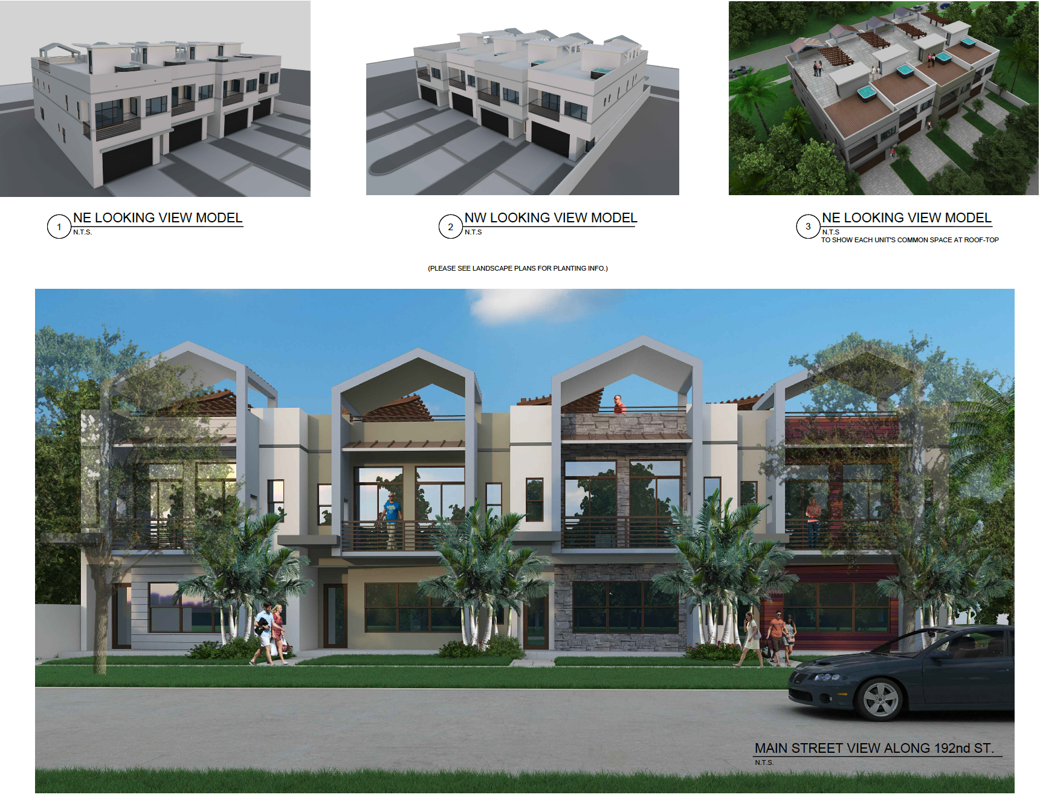
Architectural Drawings

Slide 13
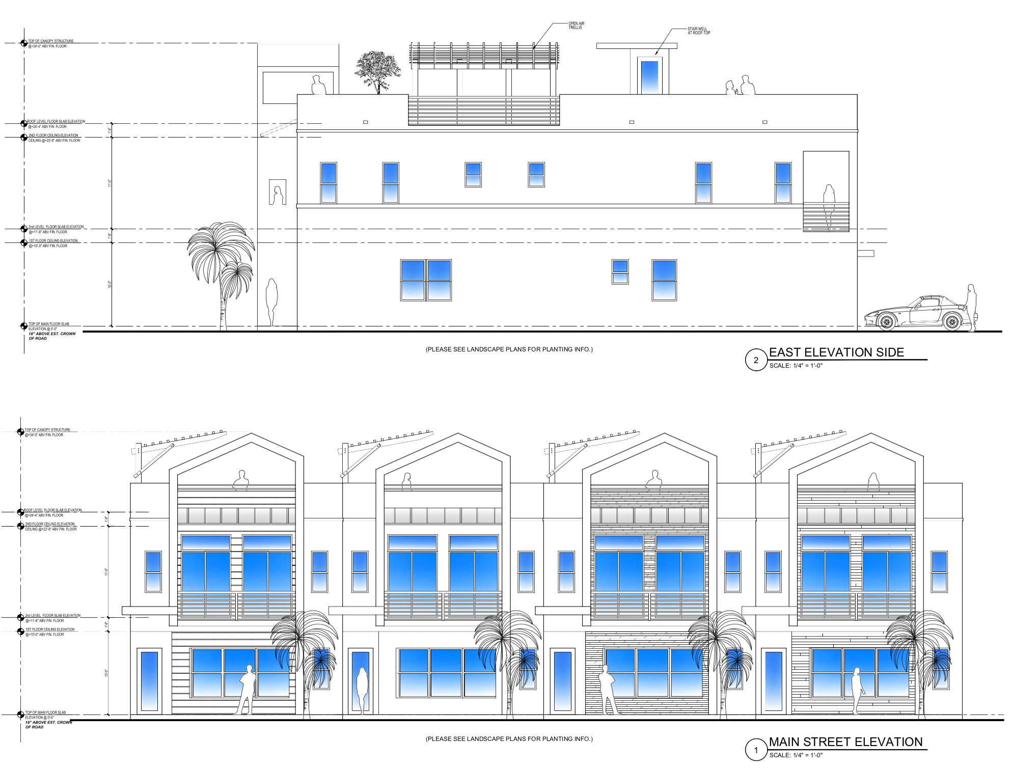
Architectural Drawings

Slide 14
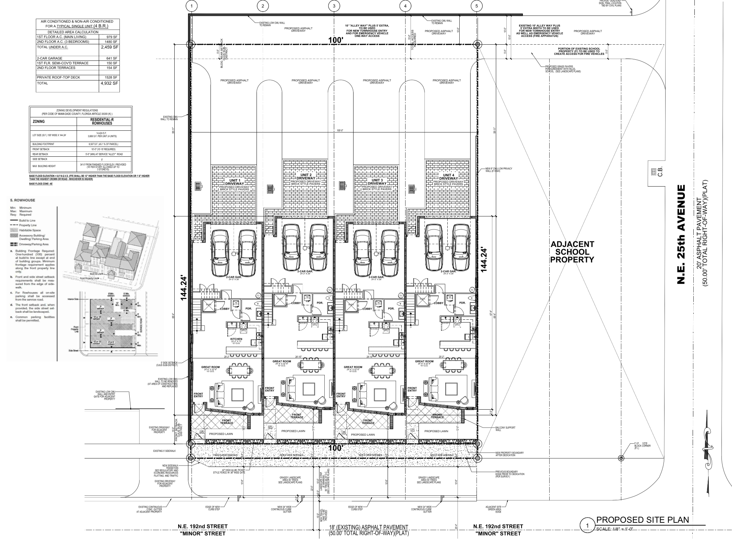
Architectural Drawings

Slide 15
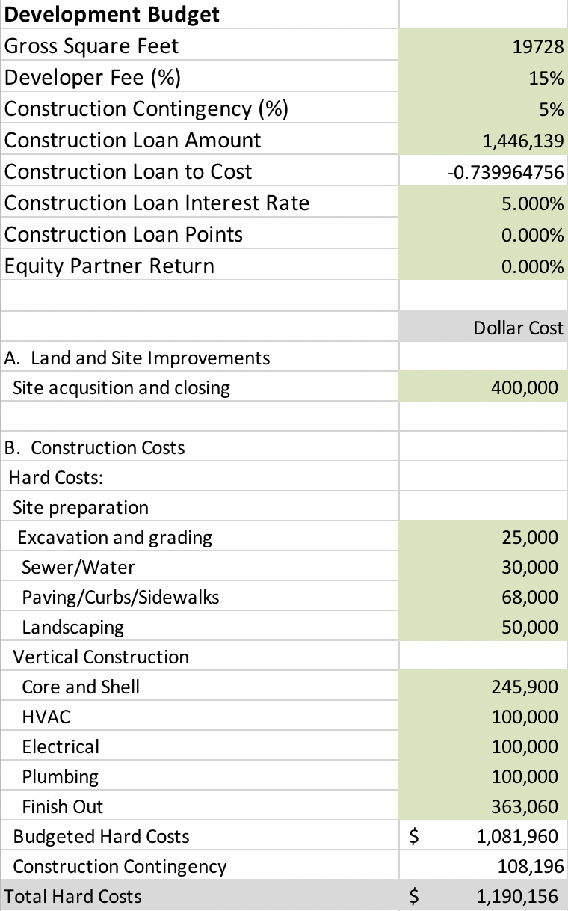
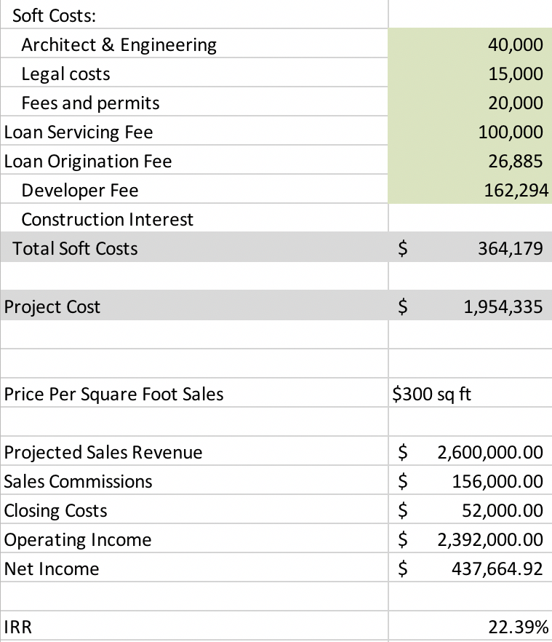
Development pro forma: cost assumptions
Source: RSMeans Cost Data Books, expert opinion, market evidence

Slide 16
3. Conclusions

Slide 17
Optimized development concept
The project appears feasible under the market-justified cost and revenue assumptions and with the preliminary development concept in mind. Scenario reflecting preliminary concept drawings achieves IRR of 22.39% with land acquisition price of $ 400,000 as indicated by investor.
It is recommended to develop parcel simultaneously without phasing the 4 townhouses project. Such development volume can reasonably be absorbed within single development cycle (i.e. 12 month for construction and 6 month after construction completion).

Slide 18

Contacts
Presented by Nick Polyushkin
Managing Broker with Vera Realty
www.verarealty.com
Office:1.305.833.33.03
Cell: 1.352.222.25.26
Email: nick@verarealty.com
© 2018 Vera Realty. All rights reserved.
The information and projections are indicative only and do not constitute a forecast of the actual income, profits, returns or cash flow.

